Slide 1
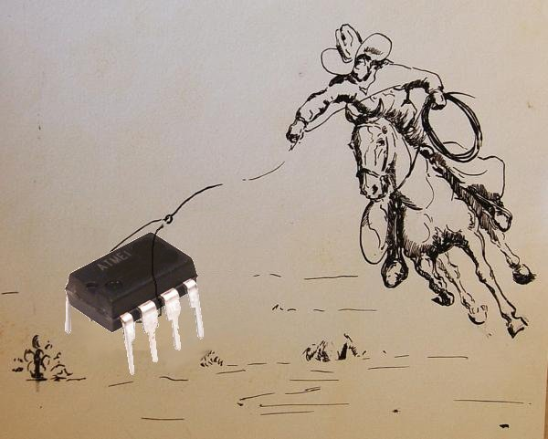
Parts Wrangling

Slide 2
Before we Begin – Gadget 1
Gadget one assembly
  Circuit Boards and Stencils are here
  Get started this week.
    Extra office hours
  REL is ready and waiting for you
  March 25th – housing design
  April 1st – housing complete
  April 8th – case study plus complete firmware

Slide 3
Extended Office Hours
Monday (today): 8:30-10
Tuesday 4:30-6:30
Thursday 6:30-7:30+
Friday 7-8
Sunday 6:30-7:30

Slide 4
What this lecture covers
Sourcing parts
  Skimming datasheets
  Finding a good part
  Writing it down
Capturing parts to Eagle
  Library editor
  Three sections to every part
  Verifying the package
  Connecting the pins
  Using the new library
Finding other people’s libraries

Slide 5

Part Sourcing
Our giant BoM was basically cheating
  Knowing how to source parts is very important
  Your mental understanding of what is available dramatically affects your designs
Other various details:
  It’s bad to design for obselete / non-existent parts
  Random part #s in a BoM can yield….very random parts
  Lazy/quick replacements don’t always work
  You can order the wrong size/shape/get the shape wrong
You need to be able to wade in and find your own parts

Slide 6
Finding Parts
Sadly, searching in a poorly Googleable niche
A few search engines exist
  www.findchips.com
  www.octopart.com
  But, you usually need to know a specific part number
A few distributors have reasonable search ability
  www.digikey.com
  www.mouser.com
  Can refine the search parametrically

Slide 7
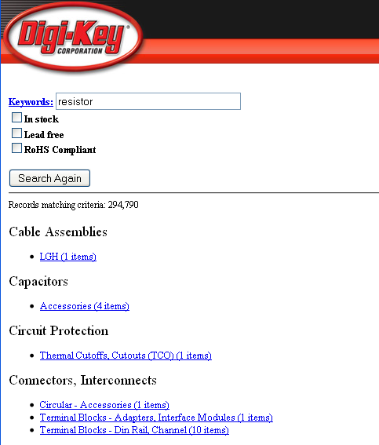
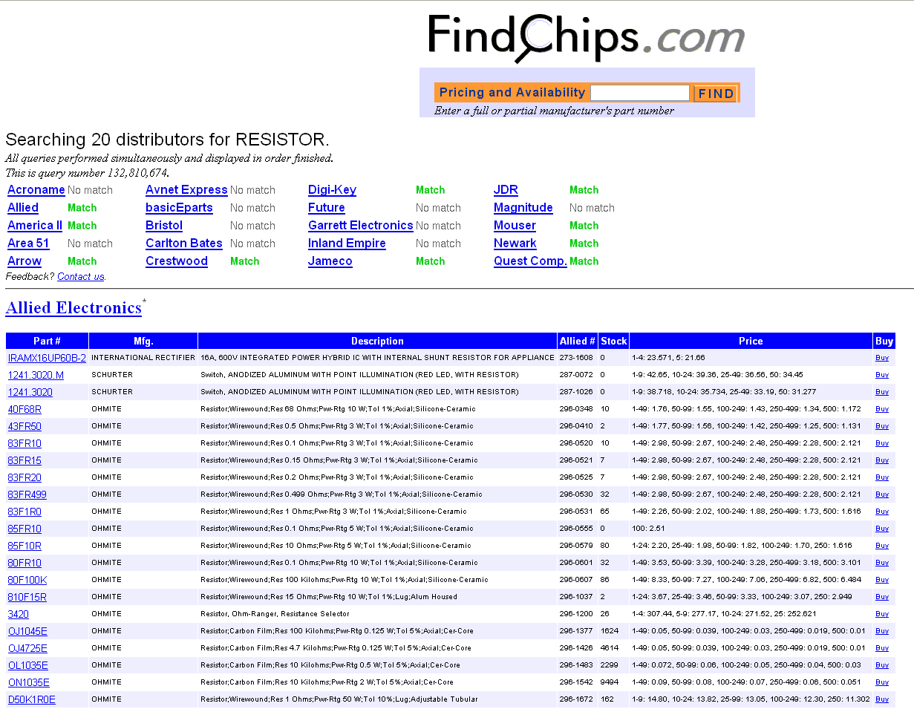
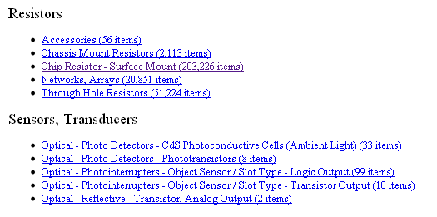
Finding a Part
The options can be overwhelming
Knowing what you want is important!

Slide 8
Fungible Parts
For the most part, a discrete is a discrete
  Resistors
  Capacitors
  Inductors
  Diodes (including LEDs)
Most important search criteria
  Electrical value
  Package aka size / shape
  Other electrical characteristics (Max Voltage, Reverse Breakdown, etc.)
  Cost and availability

Slide 9
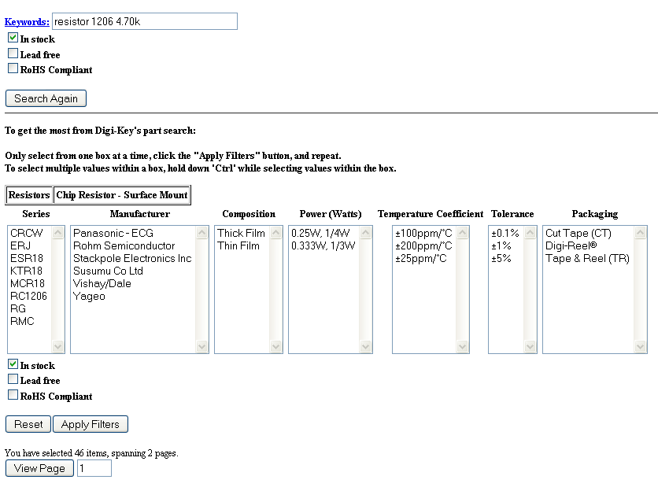
Finding a Part
Being Specific Helps
Search for ‘resistor 4.7k’
Better: ‘resistor 4.7k 1206’
In-stock is good to check
Packaging:
  Cut Tape / Bulk / Tube are hobbyist quantities
  Tray or Tape & Reel is cheaper per part, but you get a ton

Slide 10
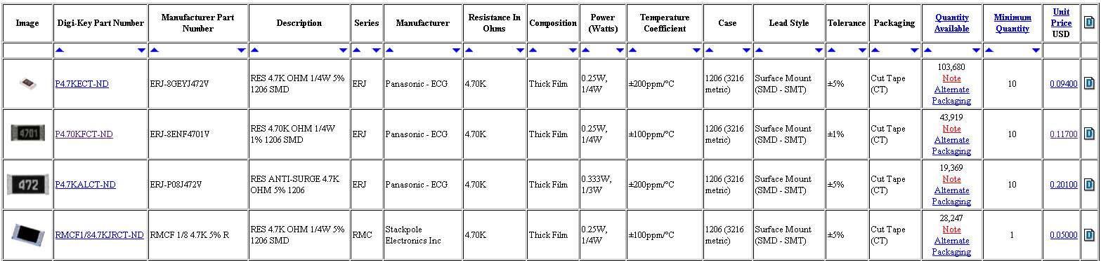
Narrowing it Down
Decide if the differences matter
Pick one and write it down

Slide 11
Navigating semi-fungible parts
Some things do the same thing completely differently
Microcontrollers
  Atmel AVR – attiny, atmega, atxmega, avr32
  Microchip PIC – 12f, 14f, 16f, 18f, dspic…
  Parallax Basic Stamp, Propellers…
  8051 / HC16
  ARM7, ARM9, Xscale…
Sensors / Actuators
  Accelerometers – analog, I2C, SPI
  Different brands have different pinouts, requirements, etc.

Slide 12
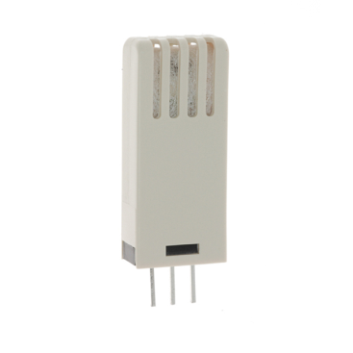
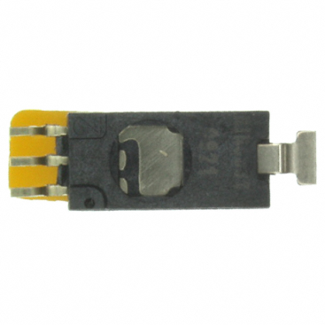
Navigating semi-fungible parts
Usually it’s easier to stick with what you know
But be sure to check periodically
Newer is almost always better
Example:
  CHS-MSS vs. HIH-5031-001
  Both humidity sensors
  $24 vs. $13
  5V vs. 3V
  TH vs. SMT

Slide 13
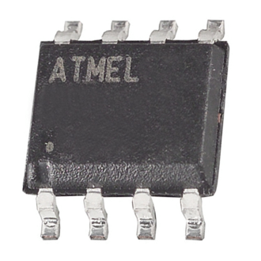
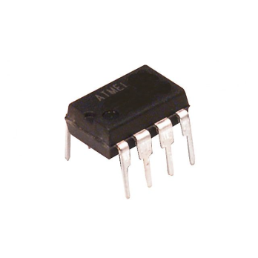
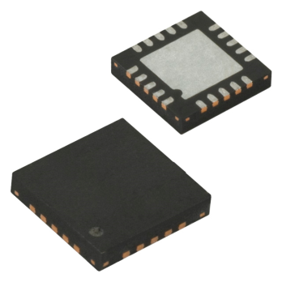
Wading through very similar parts
Pin-Compatibility
  Part options: AtXmega16A4 / AtXmega32A4 / AtXmega64A4
  Many, many logic gates (cmos vs. ttl vs. fast ttl vs. open drain)
  A wide variety of “knockoffs” or generics (MAX232)
Package Variants
  Attiny85-SU vs. Attiny85-PU vs. Attiny85-MU
  The thing you are most likely to get wrong

Slide 14
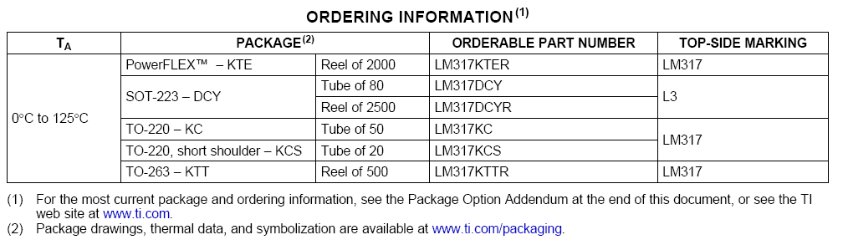
Package Variations
Usually differentiated only by a letter or two
All of the packages are usually in the same datasheet
Usually your only help is a horrible table like this:
Be Paranoid

Slide 15
Helpful Package Standards
Discretes
  1206 is what you used on your gadgets (1.2mm by 0.6mm)
  0603 is half as big in each dimension, 0201 is 1/36th the area.
  1210 is slightly wider (usually used for capacitors), and so on
  Non-LE diodes are different – SMA, SMB, SMC
SOT223 is a good-sized SMT regulator
TQFP, SOIC are usually good for ICs
  Avoid QFN or anything LC* (no legs!), but they are skilletable
  BGA is very bad for hand assembly

Slide 16
Small Outline Package
SOIC / SOIC Wide / SOIC Narrow / SOP / SSOP/ TSOP / TSSOP / TVSOP
Usually the more letters, the smaller it is
Key differences are pitch and body dimensions
  Pitch – space between leads or legs
The only way to be sure is to:
  Verify the part number and find the dimensions in the datasheet
  Check the datasheet against the eagle library
  Verify the pitch, width, and pin numbering

Slide 17
Using Eagle to create parts
Every part is divided into three parts
Package
  The physical representation of the part.
  What you see in Layout view
Symbol
  The logical representation of the part
  What you see in Schematic View
Device
  A place to tie the package to the symbol
  Lets you re-use common packages on different parts
  Lets you re-use common symbols on package variants
See the Handout:
Course Documents -> Creating Eagle Libraries

Slide 18
First Step in Making Packages:
Make sure you actually have to
Find the datasheet for your part
Find the drawing for your package
  Sometimes you get lucky with a ‘recommended land pattern’
  Sometimes they reference another datasheet elsewhere
See if it matches something you already have
Look around a bit more since laziness is good
  Check random eagle parts libraries, particularly smd*
  Check the internet, particularly sparkfun / hobbyists
Sigh and then open Eagle to make it yourself
  File -> open library / create a new one

Slide 19
Making the Package
Click the ‘package’ button to edit a package
Give it a sensible name (either a part # or package)
Use SMD / PAD to put down pads
Draw lines in layer tplace/tnames as necessary
Put down magic text: >NAME and >VALUE
Helpful Hints
  Always center your part around 0,0 – much easier to work with in layout!
  Adjusting the grid spacing to the pitch saves a lot of time
  Can group bunches of pads to move a row to the right offset
  Always verify your pins are in order

Slide 20
Making the Symbol
Click the ‘symbol’ button to edit a symbol
  (no need to save your package in between)
Name it something useful – mfg part number, digikey part number, or be sure to put that information in the description.
Put down pins in a desired arrangement
Draw some lines so it looks part-like
Add magic text (>NAME, >VALUE)
Helpful Hints
  You can group pins by function, not by number
  You can ‘change visibility’ to put the pin #s here or there
  Labeling pins with text can make parts easy to understand
  Drawing simple diagrams can obviate a lot of labeling

Slide 21
Making the Device
Click the Device button
Give it a name similar to your symbol
In the main area, type ‘add’, insert your symbol
Then hit ‘new’ and add your package
Then hit ‘connect’ and connect the two
  Be sure to get this right
  Check back and forth with the datasheet
  Go back to I again just to be sure
If there’s a green checkbox, you’re good to go!
Helpful Hints
  If your pins have the same names, this is a lot easier…
  You don’t need to connect all pins in a package, but must connect all pins in a symbol

Slide 22
Some shortcuts
Using packages from other libraries
  Open your library
  Navigate using the library pane to the donor library
  Right-click on the desired package and choose ‘add to library’
  Now you can use it in your devices!
Using other libraries wholesale
  Sparkfun and others have a wide variety of interesting parts already in libraries
  It’s still up to you to verify that the parts match the datasheet

Slide 23
Homework
Part A – Eagle Practice
  Create library parts for specific parts we’ve chosen
  No Copying – make all packages/symbols from scratch

